Slide 1

Analysis of E-Commerce Dataset
Ishaan Nirmal
Pawan Thakur
Rahul Lamge
Soumyadip Ghatak
Shayantam Das

Slide 2
About our dataset
This dataset consist of customer transaction details.
The dataset provides a opportunity to let us explore in different angles like
Most bought customer categories.
Trend of sales over the day,week,month.
Number of products bought by each customer.
Building a Recommendation Engine
Building a Sequential Model

Slide 3
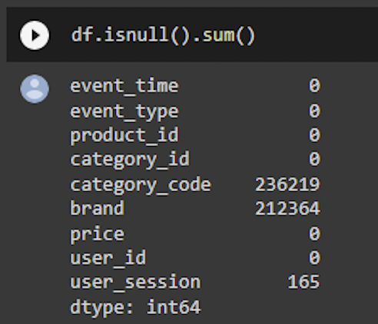
Null values in our initial dataset.
Initially our dataset consisted of 236219 and 212364 null values in category_code and brand.
Dropping this null values would lead to excessive information loss.
So we had to manually input the values based on the product price and referring to online store to find the category.

Slide 4

Criteria for value imputation
From the last slide we saw that “Category_code” and “Brand” were the variables that had null values.
For the brands whose category code were missing we have compared the prices from websites like amazon, alibaba and we have taken intuitive guess.
And for the products whose both category code and brand is missing, we have dropped them as of now for EDA purposes only.

Slide 5
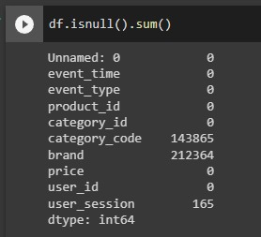
Null values
After value imputation.

Slide 6
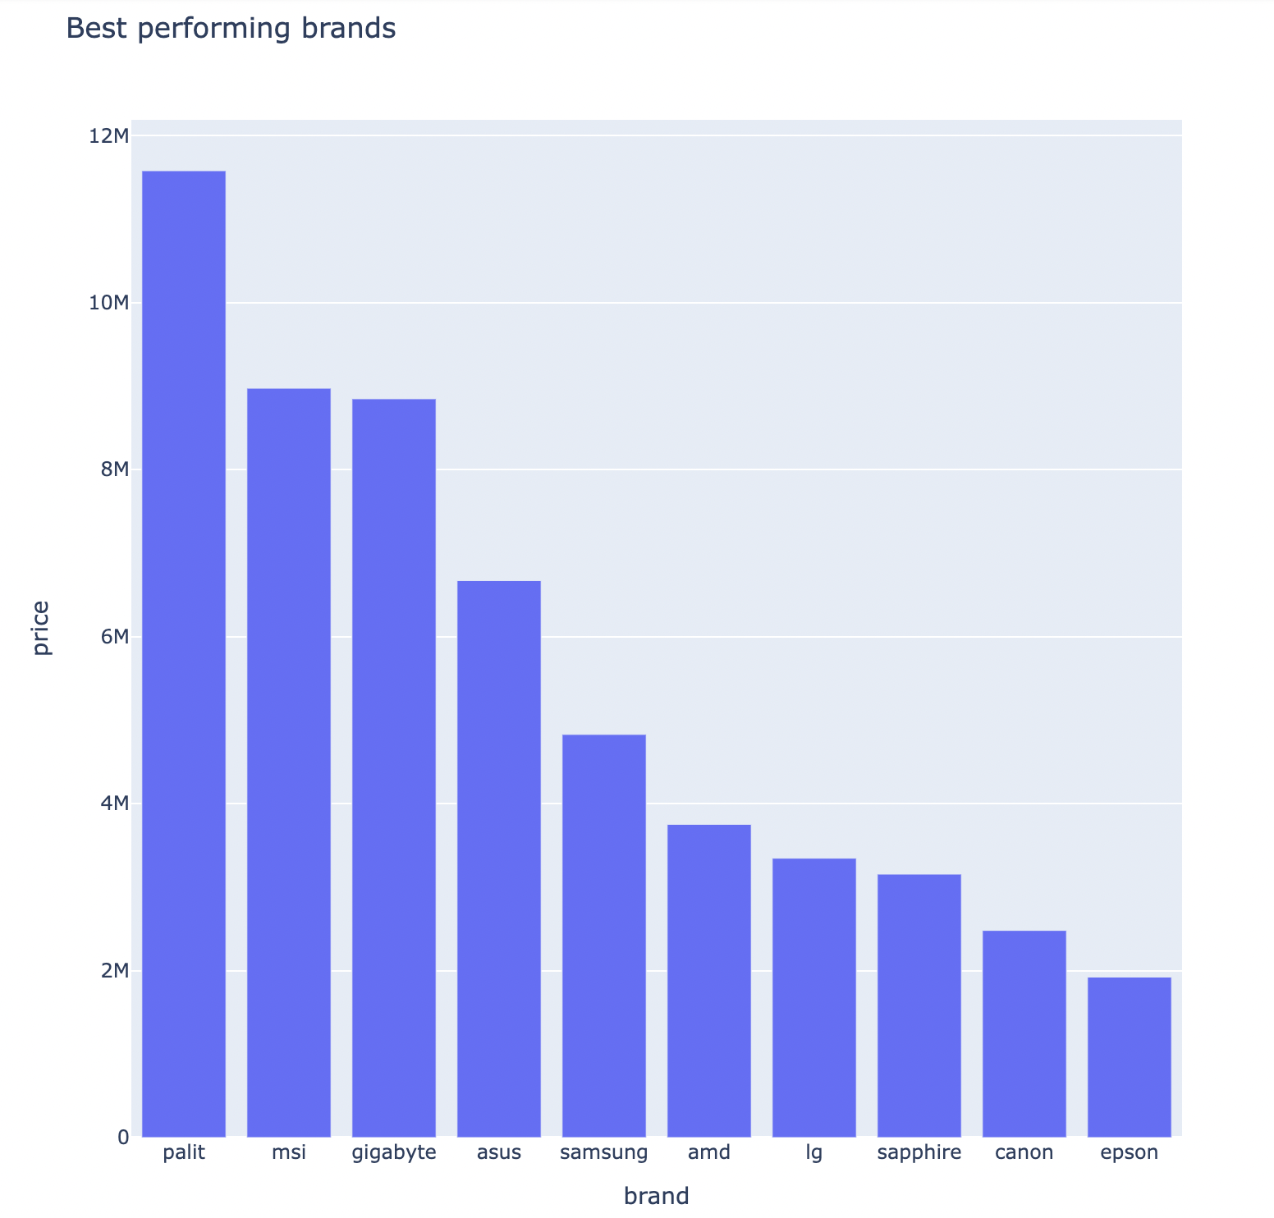
Some insights from our dataset.
Which are the expensive brands?
We grouped Brands and price together and sorted price in descending order
We have taken the top 10 brands
The top 3 most expensive brands are palit, msi, gigabyte

Slide 7
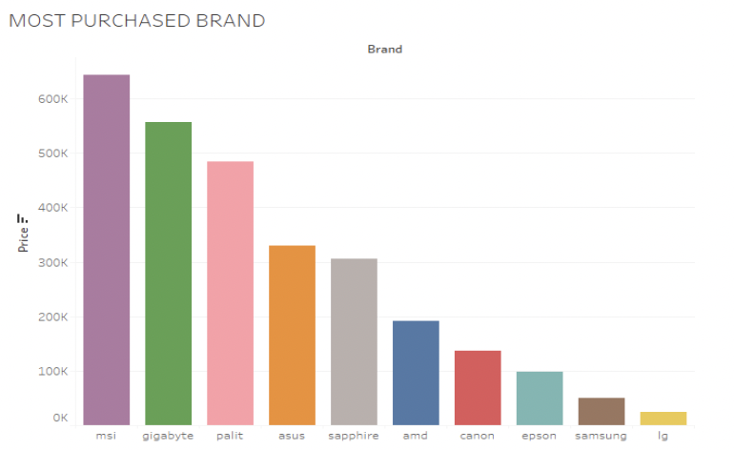
Which are the most Purchased brands?
Based on the EDA performed we can clearly
visualize that the
most purchased
brand is msi
followed by gigabyte and palit.

Slide 8
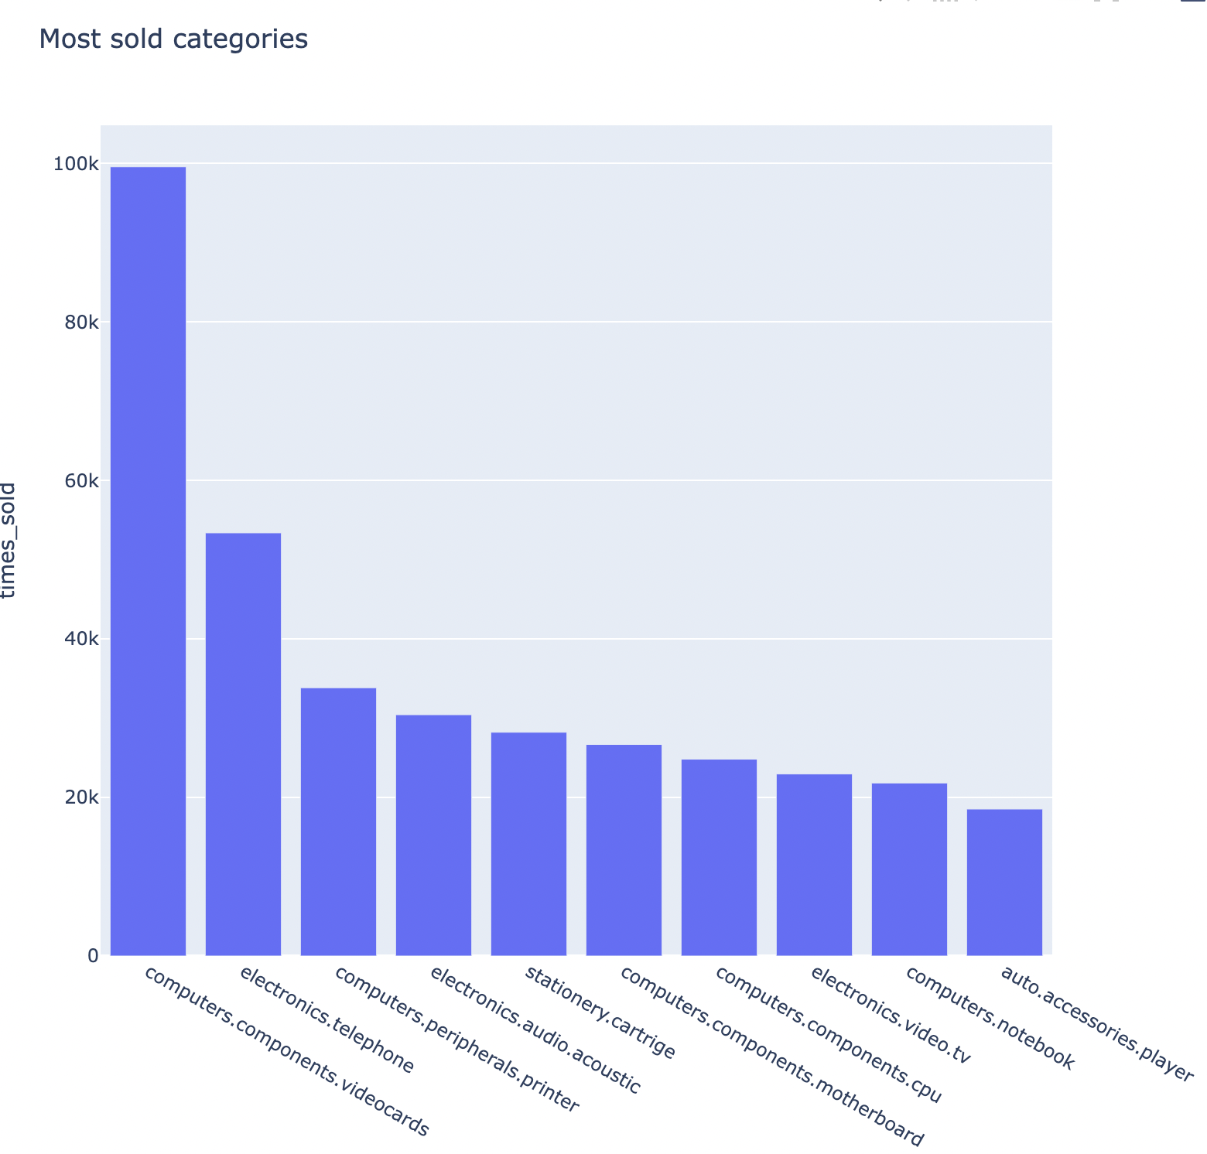
Which are the most sold categories?
The most sold item in our dataset is video cards followed by telephone and printer.
The least sold item in our dataset is notebook and player(auto accessories).

Slide 9
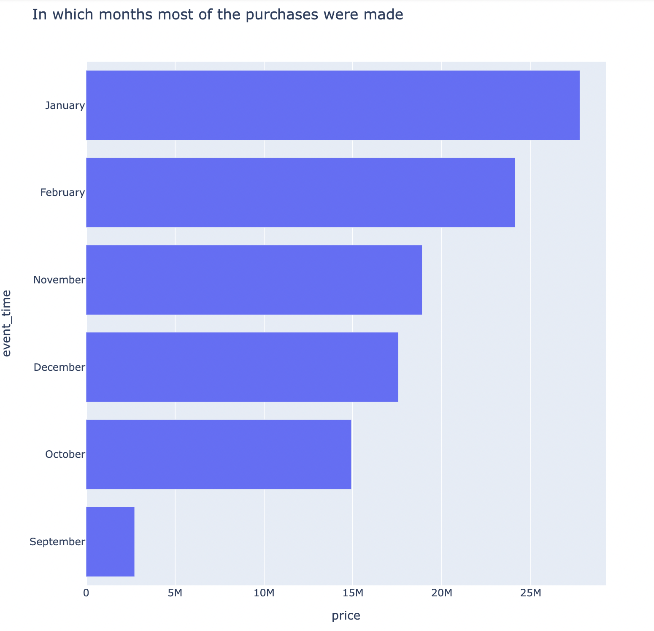
In which month most purchases were made?
January is the month with the most purchases followed by February and september being the least in terms of purchases made.

Slide 10
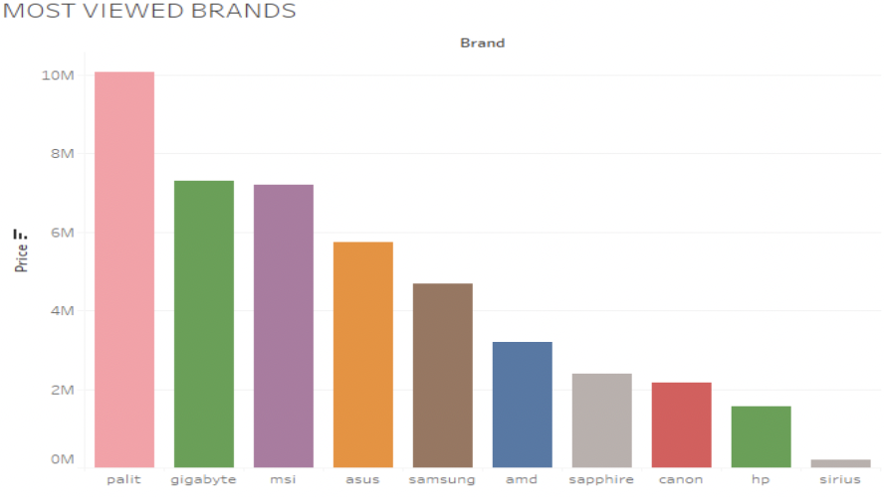
MOST VIEWED BRANDS
The most viewed brand is Palit and the least viewed brand is Sirius

Slide 11
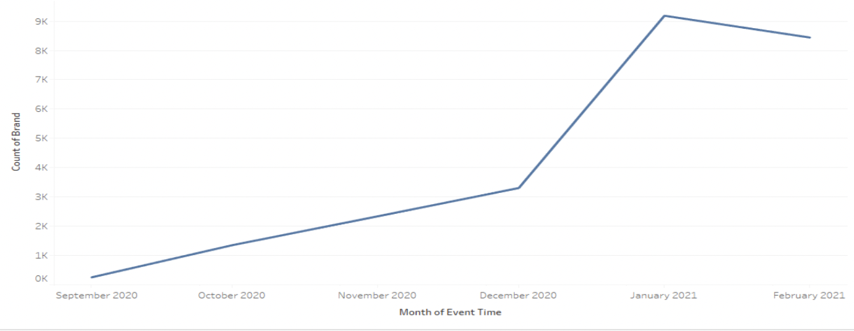
IN WHICH MONTH TOP SELLING BRAND HAD HIGHEST SALES?

Slide 12
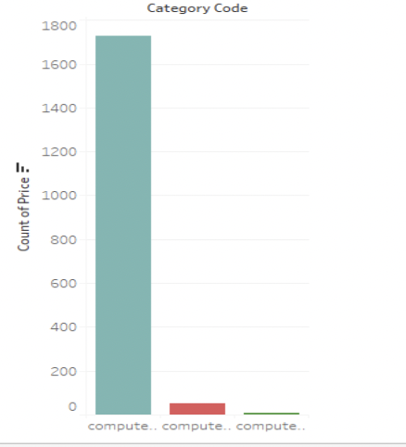
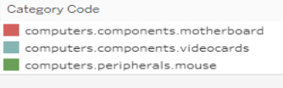
WHICH CATEGORY IN TOP PERFORMING BRAND WAS MOST POPULAR?
Video cards are most popular in the top performing brands.

Slide 13
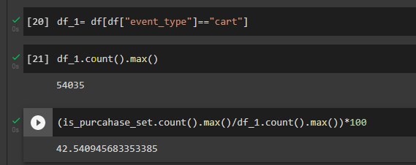
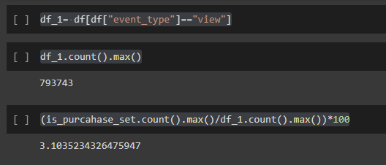
What percentage of items bought from cart to purchase and view to purchase
When the item is transferred from “cart” to “purchase” section, the percentage of items bought is around 42.54%.
When item is directly bought from “view” section to “purchase” section, the percentage of items bought is around 3.10%.

Slide 14
TIME SERIES ANALYSIS OF TOP 5 BRANDS:
We decided to do Time series Analysis of top 5 brands Which were MSI, Gigabyte, Palit, ASUS and Sapphire
So we wanted to Analyze the data with respect to purchase from which we could do sales forecasting for the brands.
We filtered the data with respect to brands and Event type as Purchase using Pivot table in Excel
We have decided to go for daily forecasting instead of monthly or weekly as we have data for 6 months only.

Slide 15
PRE-PROCESSING FOR TIME SERIES
Firstly we imported the dataset in python and converted the date into date time format.
We then grouped the data with purchase date and took the sum so that the purchases in the same date for different users are clubbed.
Then we checked if there were any null values in the series
We then tested the datasets for stationarity using Augmented Dickey Fuller test. We found that all the series were non stationary
We then Applied differencing to the dataset and found that almost all the series had become stationary after the first difference.

Slide 16
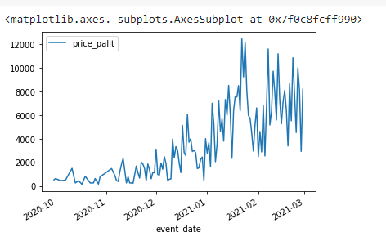
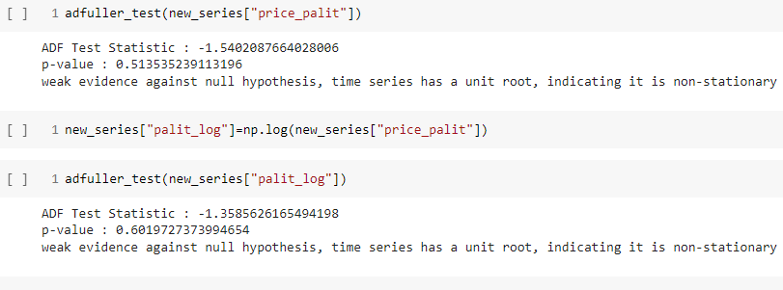
PALIT
The one at above left represents the time plot of MSI which is not Stationary
We do differencing and find it is stationary
We then Apply ARIMA and SARIMA models by looking at ACF and PACF Plots

Slide 17
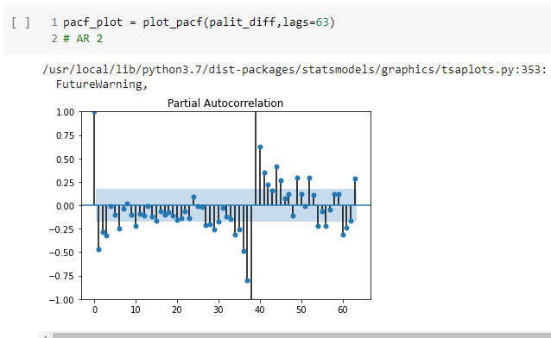
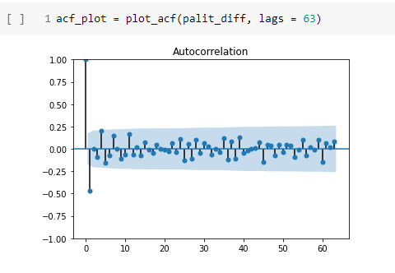
PACF-ACF PLOTS
The one on the left is a PACF Plot and the one on the Right is an ACF Plot
The plots show that the series is following an MA model of Lag 2
We apply ARIMA model with AR=0 I=1 MA=1.

Slide 18
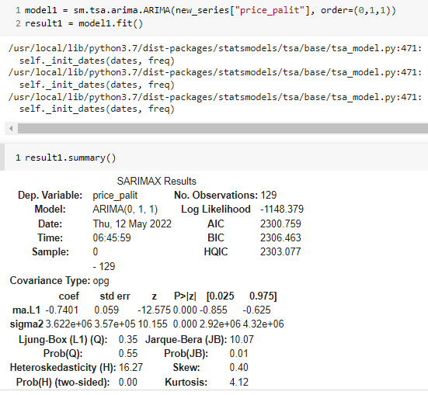
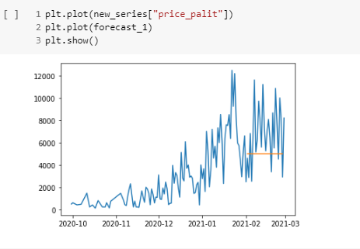
ARIMA FORECASTS
We can see ARIMA is not giving a good forecast so we conclude that there is a seasonal component in the series.
So, next we tried doing applying SARIMA model with Seasonal Order as 0,1,1, 31
We have Assumed a monthly seasonality

Slide 19
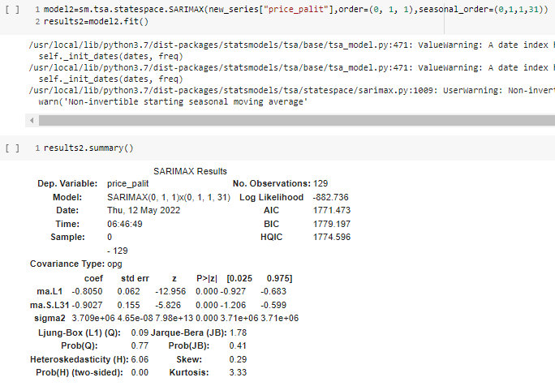
SARIMA RESULT

Slide 20
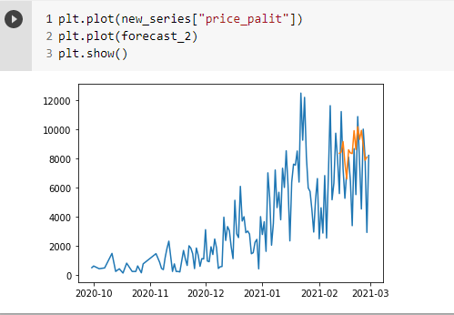
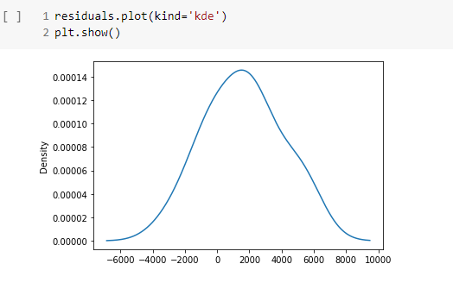
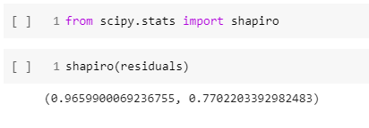
SARIMA FORECAST AND RESIDUAL NORMALITY

Slide 21
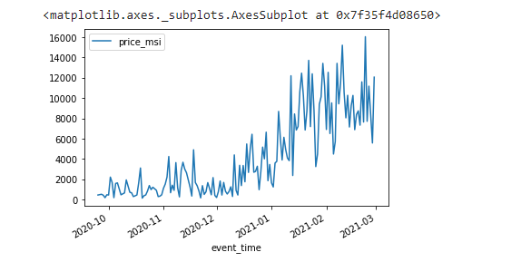
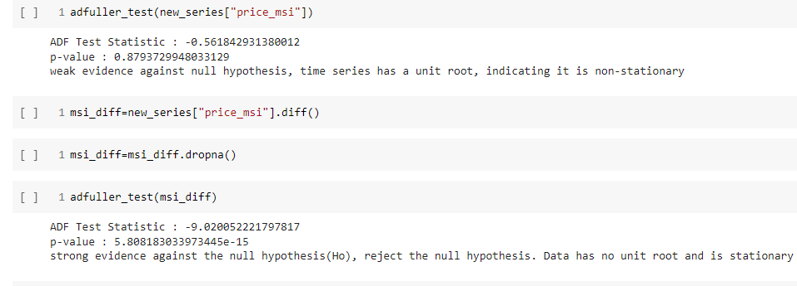
TIME SERIES: BRAND-MSI
The one at right represents the time plot of MSI which is not Stationary
We do differencing and find it is stationary
We then Apply ARIMA and SARIMA models by looking at ACF and PACF Plots

Slide 22
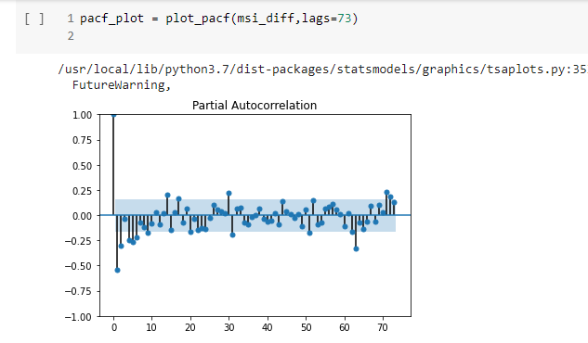
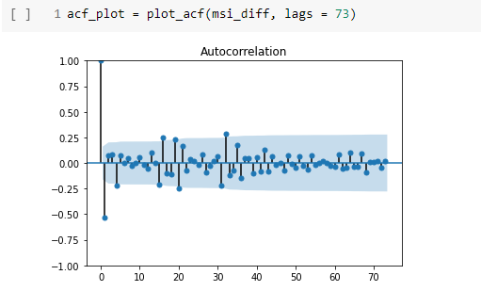
PACF-ACF PLOTS
The one on the left is a PACF Plot and the one on the Right is an ACF Plot
The plots show that the series is following an MA model of Lag 2
We apply ARIMA model with AR=0 I=1 MA=1.

Slide 23
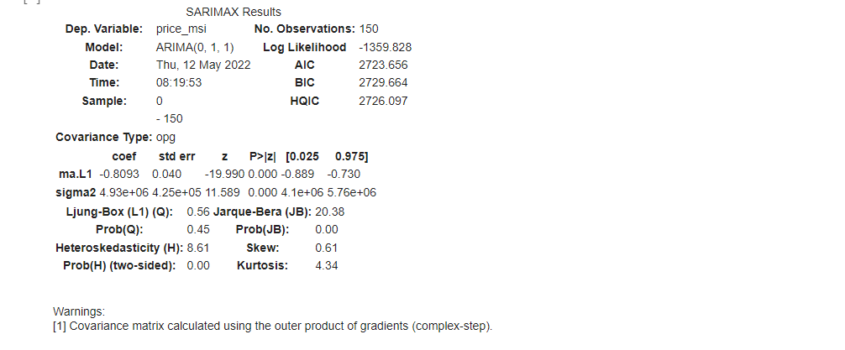
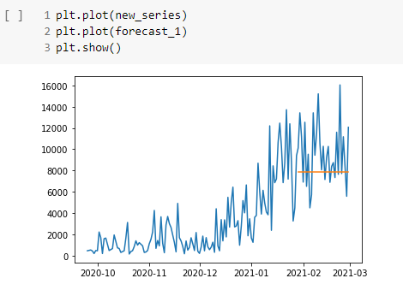
ARIMA FORECASTS
We can see ARIMA is not giving a good forecast so we conclude that there is a seasonal component in the series.
So, next we tried doing applying SARIMA model with Seasonal Order as 0,1,1, 31
We have Assumed a monthly seasonality

Slide 24
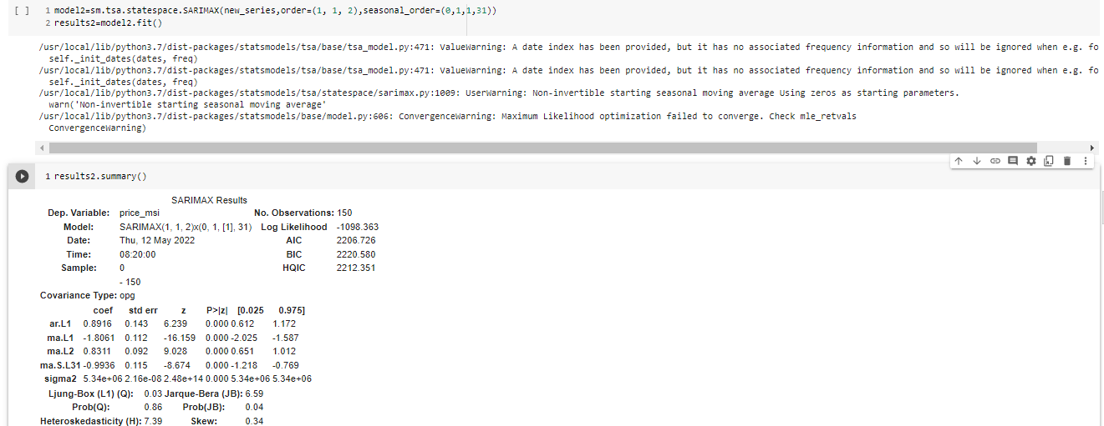
SARIMA FORECAST

Slide 25
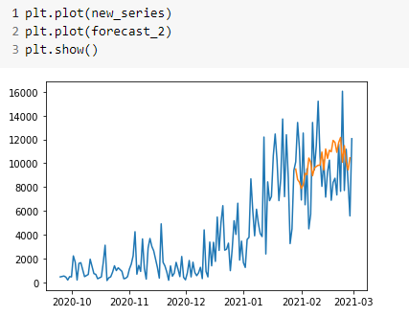
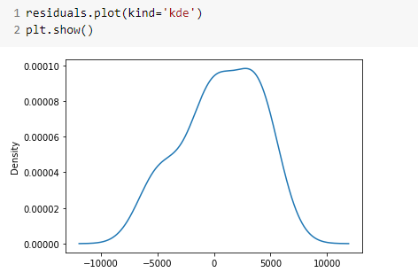
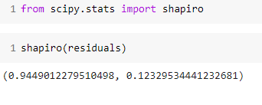
SARIMA RESULTS AND RESIDUAL NORMALITY

Slide 26
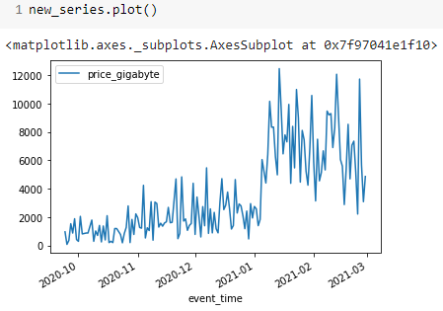
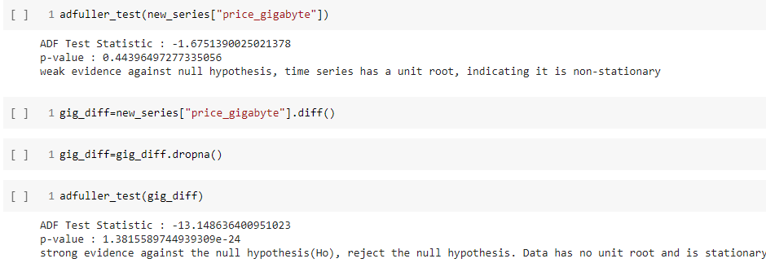
GIGABYTE
The one at right represents the time plot of Gigabyte which is not Stationary
We do differencing and find it is stationary
We then Apply ARIMA and SARIMA models by looking at ACF and PACF Plots

Slide 27
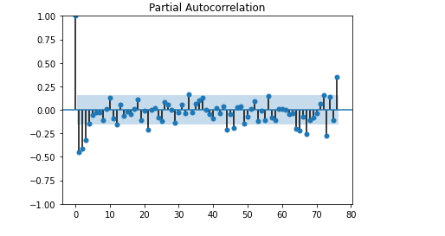
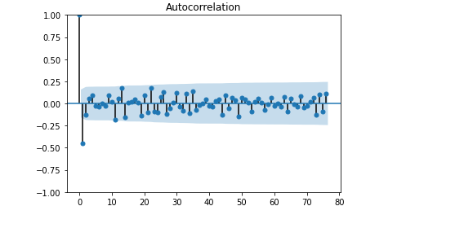
PACF-ACF PLOTS
The one on the left is a PACF Plot and the one on the Right is an ACF Plot
The plots show that the series is following an MA model of Lag 2
We apply ARIMA model with AR=0 I=1 MA=2.

Slide 28
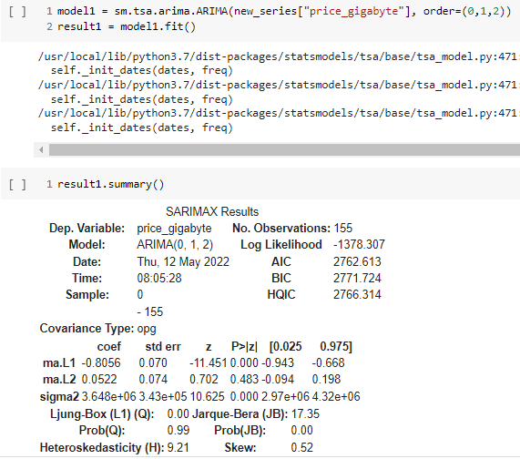
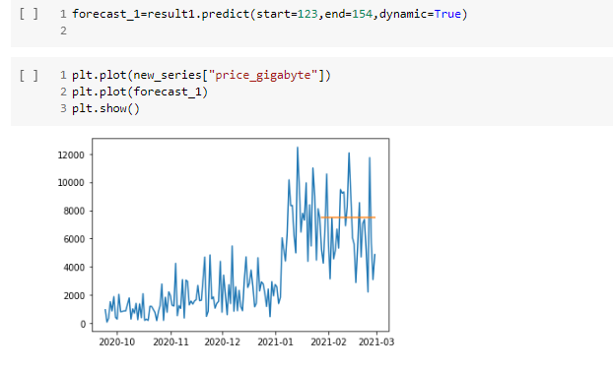
We can see ARIMA is not giving a good forecast so we conclude that there is a seasonal component in the series.
So, next we tried doing applying SARIMA model with Seasonal Order as 0,1,2, 15
We have Assumed a half monthly seasonality

Slide 29
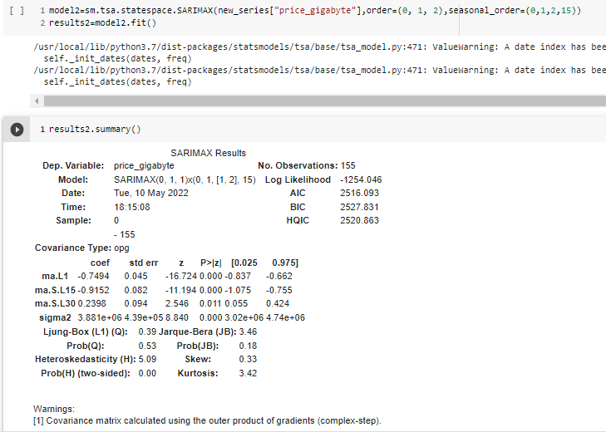
SARIMA FORECAST

Slide 30
SARIMA FORECAST AND RESIDUAL NORMALITY

Slide 31
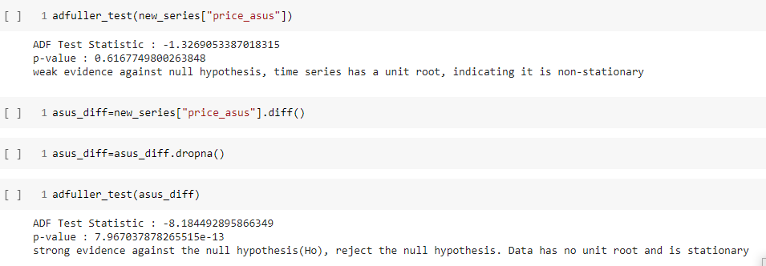
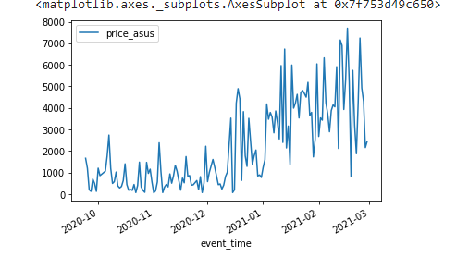
ASUS
The one at below right represents the time plot of ASUS which is not Stationary
We do differencing and find it is stationary
We then Apply ARIMA and SARIMA models by looking at ACF and PACF Plots

Slide 32
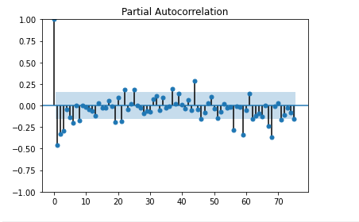
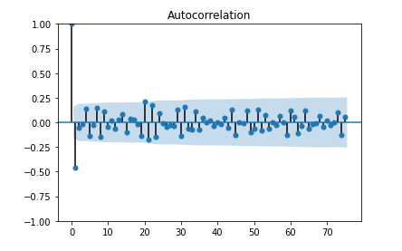
PACF-ACF PLOTS
The one on the left is a PACF Plot and the one on the Right is an ACF Plot
The plots show that the series is following an MA model of Lag 2
We apply ARIMA model with AR=0 I=1 MA=1.

Slide 33
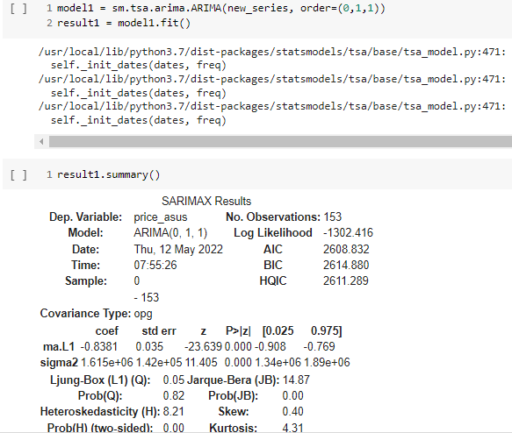
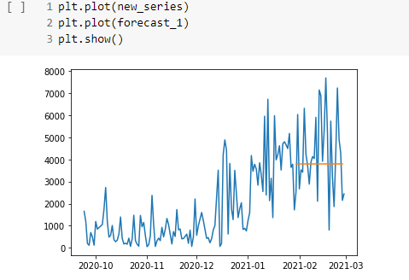
ARIMA FORECAST.
We can see ARIMA is not giving a good forecast so we conclude that there is a seasonal component in the series.
So, next we tried doing applying SARIMA model with Seasonal Order as 0,1,2, 31
We have Assumed a half monthly seasonality

Slide 34
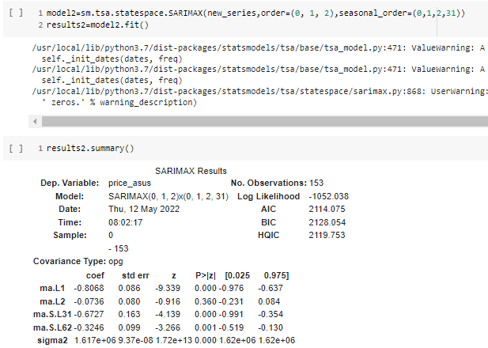
SARIMA FORECAST

Slide 35
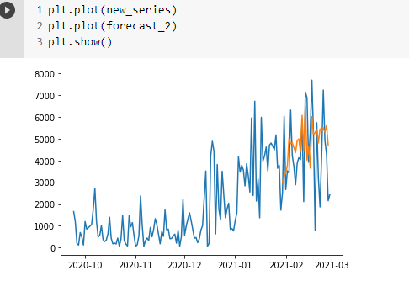
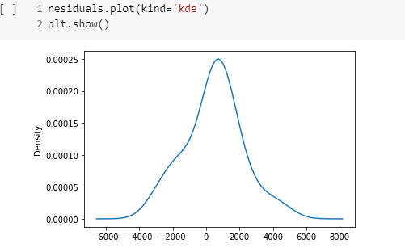
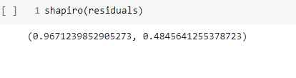

Slide 36
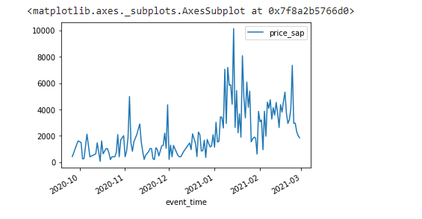

SAPPHIRE
The one at left represents the time plot of Sapphire which is not Stationary
We do differencing and find it is stationary
We then Apply ARIMA and SARIMA models by looking at ACF and PACF Plots.

Slide 37


ACF AND PACF PLOTS
The one on the left is a PACF Plot and the one on the Right is an ACF Plot
The plots show that the series is following an MA model of Lag 2
We apply ARIMA model with AR=0 I=1 MA=1.

Slide 38


ARIMA FORECASTS

Slide 39

SARIMA RESULTS

Slide 40



SARIMA FORECAST AND RESIDUAL NORMALITY

Slide 41
PRE-PROCESSING FOR RECOMMENDATION ENGINE
Imported original dataset that we manually imputed.
Groupby user_id and product_id .
Count of views, cart and purchase separately.
Created user rating matrix using count as rating.
Trained SVD on that matrix

Slide 42


RECOMMENDATION ENGINE

Slide 43
PRE-PROCESSING FOR SEQUENCIAL MODELLING
Imported original dataset that we manually imputed.
Groupby user_id and event_time.
Extracted sequence of event_type for every unique user.
Created LSTM model to predict next event_type based on previous sequence

Slide 44

RECOMMENDATION ENGINE SEQUENCIAL MODELLING

Slide 45

RECOMMENDATION ENGINE SEQUENCIAL MODELLING

Slide 46
CHALLENGES IN SEQUENCIAL MODELLING
Predicting next product ID.
More than 20k products.
Accuracy very low.

Slide 47
OUR SOLUTION
Embedding Layer
LSTM CNN hybrid architecture.
Accuracy much better compared to previous.

